Slide 1
Immigrant Entrepreneurs:
The Face of the New Nashville
Galen Spencer Hull
HULL International LLC
Presentation at the Inaugural Meeting of the
Tennessee Immigrant and Minority Business Group
September 26, 2013

Slide 2
Immigrant Entrepreneurs: The Face of the New Nashville
Historical Perspective on Immigrant Population Growth in Nashville
In 2001 the Center for Immigration Studies undertook a study of immigration trends in the U.S. in which they described the development of “New Ellis Islands”.
Here are a few of the conclusions from the 2001 study:
  An estimated 1.3 million legal and illegal immigrants were settling in the country each year.
  In the past immigrant settlement had been mostly confined to a few states; California, New York, and Florida accounted for more than half of the nation’s foreign-born population.
  However, immigrants were increasingly settling in areas that until recently had been largely unaffected by immigration.
  Those counties in which the number of new legal immigrants was equal in size to at least half of the existing foreign-born population in 1990 were designated as “New Ellis Islands”.
  One out of 14 counties in the U.S. met the criteria of a New Ellis Island. While these counties could be found throughout the U.S., the new areas of immigrant settlement were in 131 counties in the South
  Georgia had the most counties identified as New Ellis Islands with 25, followed by Minnesota and Kentucky with 18 counties each. Virginia had 13 such counties, while Tennessee and North Carolina had 12 each.
  The new areas of immigrant settlement tended to be associated with immigration from Mexico or India or with refugee resettlement. Mexico was the leading sending country, followed by India.
  Nashville ranked first in the number of new immigrants relative to its foreign-born population in 1990 in the 100 largest metropolitan areas. Atlanta was second and Louisville third.

Slide 3
Immigrant Entrepreneurs: The Face of the New Nashville
Historical Perspective of Immigrant Population Growth in Nashville
In October 2003 the Urban Institute published the report of a study for the Building the New American Community Project entitled Profile of the Foreign-Born in the Nashville Economic Market , supported by the U.S. Department of Health and Human Services.
Here are a few of the findings from that study:
  While the share of the Nashville Economic Market’s foreign-born population (5%) was less than half the national average (11%), immigration to the region was growing rapidly:
  The foreign-born population grew by 203% between 1990 and 2000, almost four times the national average (57%).
  40% of the Nashville Economic Market’s immigrants arrived after 1995, compared with 24% nationally.
  The share of the foreign born in Metro Nashville-Davidson County was slightly higher (7%) and grew by 213% during this period.
  The state of Tennessee’s foreign-born population grew by 169% between 1990 and 2000.
  In 2000, Tennessee ranked sixth in the nation in the rate of its immigrant population growth.
  Nonetheless, despite rapid growth, only 3% of the state’s population by 2000 was foreign-born.

Slide 4
Immigrant Entrepreneurs: The Face of the New Nashville
Historical Perspective of Immigrant Population Growth in Nashville
  Drawing upon the 2000 census, the 2003 study noted that Latin Americans constituted the largest foreign-born population in the Nashville Economic Market (40%). But there were also significant representations from other immigrant-sending regions: Asia (32%) including the Middle East; Europe (16%); and Africa (8%).
  Mexico was by far the largest country of origin (27%), followed by Germany, Korea, Laos, Canada, India, and Iraq. The African population (8%) in the Nashville Economic Market was nearly triple the national average of 3%.
  The largest African groups were from Nigeria, Egypt, Ethiopia, and East Africa, concentrated in Cheatham, Davidson, Dickson, Maury, Montgomery, Robertson, Rutherford, Sumner, Williamson, and Wilson Counties.
  49% of the Nashville Economic Market’s immigrants who arrived during the 1990s were born in Latin or North America, considerably more than the 17% indicated by the INS admissions data.
  At the same time, INS data showed that 52% of 1990s entrants were born in Asia versus only 29% shown in the Census. The shares of immigrants born in Europe and Africa were also higher in the INS than the Census data.
  These contrasting data suggest that a significant proportion of the Economic Market’s Latin American immigrants were undocumented.

Slide 5
Immigrant Entrepreneurs: The Face of the New Nashville
Tennessee foreign-born change since 1990: top ten countries of origin 1990-2006
Rank Country 1990 Country 2000 Country 2006
1 Germany 6,458 Mexico 44,682 Mexico 4,254
2 United Kingdom 4,201 Germany 8,316 India 11,848
3 Canada 4,087 India 7,701 China 9,933
4 India 3,282 Canada 6,981 Germany 9,349
5 Korea 2,965 China 6,141 Canada 8,654
6 Japan 2,577 Korea 6,106 Philippines 4,784
7 Philippines 2,209 Vietnam 5,949 El Salvador 4,136
8 Laos 2,133 United Kingdom 5, 726 Vietnam 4,094
9 Mexico 1,972 Philippines 4,078 England 3,381
10 China 1,740 Laos 3,669 Cuba 3,070
All Others 27,489 All Others 59,655 All Others 133,503
Total 59,114 Total 159,004 Total 100,013

Slide 6
Immigrant Entrepreneurs: The Face of the New Nashville
Profiles of Foreign Born Populations in Tennessee
Hispanics
By far the most prominent segment of the foreign-born population in Middle Tennessee is that comprised of Hispanics.
More data is available on Hispanics than other groups owing to the work of the Pew Hispanic Center which tracks
Hispanic population trends throughout the U.S.
There was a veritable explosion in the Hispanic population in Davidson County, from 4,775 in 1990 to 46,546 in 2007.
From 1990 to 2000 the Hispanic growth rate was 446% while from 2000 to 2007 it slowed to 78%.
Hispanics represented 5% of the county population in 2000, increasing to 8% in 2007. Davidson County was among the
highest in the country, both in terms of absolute number of Hispanics and rate of growth.
Hispanics are prominent in the trades and service sector.
East Indians
The first trickle of immigrants from India and the sub-continent began arriving in the area 35 years ago and they now number more than 5,000. The first to arrive were mainly doctors who came with few restrictions, since with the creation of Medicare there was a shortage of native-born doctors in the U.S.
The overwhelming majority of Indian immigrants from the very beginning were professionals— software engineers, doctors, hotel and restaurant managers and owners, and academics—and more recently real estate and life insurance agents as well as immigration lawyers.
Today Indian faculty and students are prominent at Vanderbilt University and other local universities, especially in the sciences and engineering. East Indian immigrants reflect the diversity that is Indian society - Hindus, Muslims, Christians, Sikhs, and Jains—from all corners of rural and urban areas of the sub-continent.

Slide 7
Immigrant Entrepreneurs: The Face of the New Nashville
Profiles of Foreign Born Populations in Tennessee
Somalis
Somali refugees from East Africa have poured into Middle Tennessee in recent years. Immigrants are chosen from UN refugee camps then undergo cultural orientation before coming to the U.S.
The humanitarian immigration program was established by the 1980 Refugee Act, controlled by the UN High Commissioner for Refugees (UNHCR) and by the US State Department. By 2007 there were an estimated 70,000 Somali legal immigrants in the US and Middle Tennessee has become one of the largest concentrations of Somalis in the U.S.
Beginning in 2004 between 400 and 1,000 Somalis were sent to Shelbyville where they went to work at the Tysons chicken processing plant. The Tyson plant generated national controversy in the fall of 2008 when it dropped Labor Day as a paid holiday in favor of the Muslim holiday Eid al-Fitr.
Somalis are most visible in the Nashville area as taxi drivers and are well represented in local high schools.
Kurds
As with Somalis, the Nashville area has seen one of the largest concentrations of Kurds in the U.S. The first group of Kurds came to the U.S. following a failed revolution against the central government of Iraq in 1975. The Kurdish leader went into exile in the U.S with many of his followers.
There were two additional waves of Kurdish refugees in 1992 in 1996 who arrived in the U.S. following periods of living in refugees camps in the Middle East.
Today the estimate of the Kurdish population in the U.S. is around 40,000, the majority from Iraq. Others have come from Iran, Turkey, and Syria. The Kurdish Yellow Pages estimates that 10,000 Kurds reside in the Nashville area and provides an alphabetical listing of Kurdish-owned businesses.
The Kurdish community is very homogeneous and well organized. The religious and cultural center of Kurdish life is the Salahadeen Center of Nashville, a non-profit, tax exempt, faith-based organization founded in 1998 to serve the Muslim and specifically Kurdish communities.

Slide 8
Immigrant Entrepreneurs: The Face of the New Nashville
Immigrant Businesses in the Nashville Area
Study conducted by TSU Faculty and Graduate Students 2008-2009
Despite the burgeoning growth of the immigrant community in Middle Tennessee and the importance of immigrant entrepreneurship to the local economy, there has been little systematic study of the nature of immigrant businesses.
In the summer of 2008 a team of faculty and students in the College of Business at Tennessee State University began a survey of immigrant entrepreneurs in Middle Tennessee. Participation and support was solicited from immigrant-based chambers of commerce and other community organizations representing foreign-born business constituencies.
Invitations were sent to two groups of ten business owners to participate in focus groups. The issues raised in these sessions were used to inform the eventual design of a questionnaire. A public forum was then held, bringing university and community partners together.
Face-to-face interviews were conducted with 32 individual entrepreneurs, selected based on region-of-origin as well as business types. Ten were Hispanic, of whom seven were of Mexican origin; six were from the Middle East; eleven were from Asia; two from Africa, and two from Europe.
Nine were restaurant owners; eight were in services such as beauty salons and clothing stores; two were in service trades; two newspaper and magazine publishers; three in trade and distribution; and six in technology and computer services.
A survey instrument was refined several times through a series of four trials and a final version emerged by January 2009. Responses were obtained from 114 respondents.
One of the most important purposes of the survey was to ascertain the concerns and needs of immigrant entrepreneurs.

Slide 9
Immigrant Entrepreneurs: The Face of the New Nashville
Immigrant Businesses in the Nashville Area
Study conducted by TSU Faculty and Graduate Students 2008-2009
Despite the burgeoning growth of the immigrant community in Middle Tennessee and the importance of immigrant entrepreneurship to the local economy, there has been little systematic study of the nature of immigrant businesses.
A team of faculty and students in the College of Business at Tennessee State University College surveyed immigrant entrepreneurs in Middle Tennessee beginning in the summer of 2008. Participation and support was solicited from immigrant-based chambers of commerce and other community organizations representing foreign-born business constituencies.
Invitations were sent to two groups of ten business owners to participate in focus groups. The issues raised in these sessions were used to inform the eventual design of a questionnaire. A public forum was then held, bringing university and community partners together.
Face-to-face interviews were conducted with 32 individual entrepreneurs, selected based on region-of-origin as well as business types. Ten were Hispanic, of whom seven were of Mexican origin; six were from the Middle East; eleven were from Asia; two from Africa, and two from Europe. Nine were restaurant owners; eight were in services such as beauty salons and clothing stores; two were in service trades; two newspaper and magazine publishers; three in trade and distribution; and six in technology and computer services.
A survey instrument was refined several times through a series of four trials and a final version emerged by January 2009. Responses were obtained from 114 respondents.
One of the most important purposes of the survey was to ascertain the concerns and needs of immigrant entrepreneurs.

Slide 10
Immigrant Entrepreneurs: The Face of the New Nashville
Immigrant Businesses in the Nashville Area
The following concerns of immigrant businesses emerged from the TSU survey:
Need for English lessons, focused on business operations
Assistance in financing and business planning
Assistance with tax preparation and filing
On-call assistance; services at unconventional times
Human resource training, technical skill development, supervisory skills
Networks for material sources, legal assistance, accessing sources of funding
Services in local immigrant communities
The following profiles of those surveyed emerged:
The two main reasons for having migrated to the U.S. were the unfavorable economic conditions and/or political instability in their country of origin.
Most respondents indicated that they bought the business they now manage, as opposed to creating it themselves.
Those who started the business themselves began alone and not with partners.
Most were sole proprietorships, some were partnerships, and a few were incorporated. None indicted that they were franchisees.
Nearly all of the respondents began their business primarily with personal savings, several using personal credit cards.
Most of them also indicated that they also relied upon family and friends for financing.
Very few had benefited from bank financing.

Slide 11
Immigrant Entrepreneurs: The Face of the New Nashville
Immigrant Businesses in the Metro Nashville Area
Secondary Data on Type of Business and Country of Origin
The Office of the Davidson County Clerk maintains a database of all businesses that operate within its jurisdiction. Files include: name and type of business, name of the owner, and mailing address (including zip code). The list is updated monthly and is available to the public for a fee.
TSU purchased the database with a view toward trying to determine which of the businesses might be run by foreign-born owners. The list we examined contained a total of 39,226 businesses. All of them were in the service sector since manufacturers are not required to have the same business license.
We identified six categories, based on the family name of the owner. These were admittedly quite arbitrary, but provided a means of getting a handle on the extent of diversity among businesses in the Nashville area. A total of 4588 were identified as likely being foreign-born (12% of the total in the database).
The categories and number of names in each category were as follows:
Hispanic: language group consisting primarily of persons from Latin America 1428
Muslim: religious group, identified primarily by Muslim names, mainly Middle Eastern 1104
Indian: geographic group of the Indian subcontinent including Pakistan, Bangladesh 377
African: geographic group, often overlapping with Muslim names 630
Asian: geographic group, consisting mainly of Chinese, Koreans, Japanese and Thais 684
European: geographic group covering Eastern and Western Europe and Turkey 365

Slide 12
Immigrant Entrepreneurs: The Face of the New Nashville
Immigrant Businesses in the Metro Nashville Area
Secondary Data on Type of Business and Country of Origin
Certain patterns were discerned when types of businesses owned in each of the six categories were examined.
Unfortunately, the coding of businesses types applied by the County Clerk’s office left something to be desired, since a sizeable proportion of businesses in all categories were coded 99, which simply means “undefined”. The prevalence of this code applied across all of our categories. Several business types were also preceded by the term “miscellaneous”.
Both African and Muslim businesses were coded highest on taxicabs. In fact, together they accounted for the vast majority of taxi drivers in the Nashville area.
The Indian, Hispanic, European and Asian categories all scored either highest or second highest on eating places. (For some reason, only Indians are coded as liquor store owners).
The next most popular type of business among Africans, Asians, and Hispanics was services to buildings, followed closely by Muslims and Europeans.
Although Indians were not listed at all in this business type, they were very prominent in hotels, motels, and tourist courts.
All were engaged in special trade contracting, and all except Hispanics were engaged in general building contracting businesses.
Hispanics tended to specialize in painting & paper hanging, masonry stonework, and carpentry while none of the other groups were coded in these businesses.

Slide 13
Immigrant Entrepreneurs: The Face of the New Nashville
Immigrant Businesses in the Metro Nashville Area
Secondary Data on Type of Business and Country of Origin
Not surprisingly, all categories of business owners were listed as owners of grocery stores and all were coded for retail stores.
The used car business was a common denominator among the Africans, Indians, Muslims and Europeans, but not the Asians and Hispanics. However, Hispanics, Europeans and Africans were more engaged in general auto repair.
Beauty shops showed up regularly among Asians, Europeans, and Hispanics, but not Indians, Africans, and Muslims.
All groups were engaged in other business services, but only Europeans and African were in management consulting and public relations.
As for location within the Nashville area, heavy concentrations of nearly all six groups of foreign-born entrepreneurs were found in the southeastern part of the city along the Nolensville Pike corridor (zip codes 37211, 37217, 37013). This also coincides with the distribution of the general population of these groups.

Slide 14
Immigrant Entrepreneurs: The Face of the New Nashville
Summary and Concluding Observations
The TSU study was sorely lacking in methodological rigor and reliable data. Nevertheless, it provides a baseline from which to ask questions regarding the nature of immigrant-owned businesses in Middle Tennessee.
Of particular relevance is the need for a comprehensive study of the economic impact of immigrant-owned businesses on the Tennessee economy. This could provide the newly formed Tennessee Immigrant and Minority Business Group with a challenge. Those participating in the initiative who are from academia might be well-placed to undertake this challenge.
Comprehensive immigration reform is on the agenda, albeit moving slowly through the legislative process. We should be able to analyze the implications of this process and determine what is in the best interest of our constituents.
Too often we hear that immigrants are taking jobs away from the indigenous population. We should be able to make the case that immigrant businesses are creating jobs and contributing to economic development.
Previous efforts to create the infrastructure for the immigrant and minority business community to have their voices heard in the public forum have not succeeded. Let us seize this opportunity to move that agenda forward!
We ask that you think about ways you can contribute to accomplishing this objective.
My own response is the creation of a new website which I am calling GlobalMusicCity.com which will shine the spotlight on the global nature of the Middle Tennessee economy and the multicultural dimensions of its population. Please join me!

Slide 16
Tennessee Immigrant and Minority Business Group (TIMBG)
Statement of Purpose and Organizational Principles
Tennessee has one of the fastest growing immigrant communities in the United States; Nashville has earned the title of an “Ellis Island” as a result. Immigrants from around the world are creating businesses and jobs, making notable contributions to social and economic development.
Background:
The increasing diversity of Middle Tennessee’s business community, an increased population, and the impact of a diverse community today:
In recent years, Middle Tennessee has attracted a growing number of immigrant and minority businesses, concurrent with the rapid rise of a diverse ethnic population. As the Tennessean reported in its article on 6/16/13 (by Duane Gang), in 10 mid-state counties from 7/2011 and 7/2012, the Hispanic population grew by 4.36%, the Asian population by 4.31%, the African American population by 2.39% and the white population by 1.81%. Nationally today, Latino Americans account for 18% of the population, African Americans 15%, and Asian Americans 6%.
The increasing isolation of various ethnic and cultural populations:
As the size of each community has grown, though there has been an increasing amount of interaction of businesses “intra” (within) each community--e.g., Korean Americans with fellow Korean Americans, or Latino Americans with fellow Latino Americans--there has been a concurrent reduction of inter-group interactions.

Slide 17
Tennessee Immigrant and Minority Business Group (TIMBG)
Statement of Purpose and Organizational Principles
Immigrant and minority businesses have much in common:
All immigrant businesses, by definition, started with nothing. We have to all go through the same struggle, i.e., starting a business in a new environment, with no family and no cultural roots. In addition to the challenges faced by all businesses, immigrant and minority businesses have to deal with additional challenges, including adjusting to a new culture, environment, language, social interactions, laws and regulations, community, staff, and in some cases, new prejudices and discriminations as well. To work hard and to have an American dream are desires that have inspired and united all of us.
Hence, there is now the rising, important need to increase inter-group interactions, i.e., to bring business communities of various ethnic groups together to help each other and to help America:
Since immigrant and minority groups have a lot in common, such a synergistic interaction between groups, this will not only benefit the people and businesses in the various groups themselves, but also be good for the economic and cultural growth of middle Tennessee as a whole, since infusion of new blood, new ideas and new initiatives will help America grow and prosper in today’s increasingly competitive global market.

Slide 18
Tennessee Immigrant and Minority Business Group (TIMBG)
Statement of Purpose and Organizational Principles
Mission of TIMBG: Establish a forum for the promotion of communication and interaction among immigrant and minority business owners. Working together, we can address common issues and further the interests of all.
Agenda of TIMBG: Convene monthly seminar meetings enabling immigrant business owners to market their services and products as well as to conduct discussion of topics of general interest to the immigrant and minority business community.
Membership of TIMBG is open to ALL business entrepreneurs, those of immigrants and minorities and those that are interested in interacting with immigrants and minority businesses.
TIMBG co-founders:
Ming Wang drwang@wangvisioninstitute.com
Galen Hull galenhull@gmail.com
Christin Duncan (secretary): christin@wangvisioninstitute.com
The process of hosting a TIMBG monthly seminar:
Send a request to host, to TIMBG founding member committee, for approval. Once approved, be responsible for hosting that month’s seminar, i.e., Set a date, find a venue, and arrange food/drinks (and responsible for the cost). Send an event e-mail, to Christin, who will in turn e-mail blast it out to TIMBG list. Format of seminar: 6:30pm-8pm, Tu/Th, 20 min social, 20 min host marketing talk,
20 min general discussion.

Slide 19
Tennessee Immigrant and Minority Business Group (TIMBG)
Co-founders
Ming Wang and Galen Hull
Founding Members of TIMBG as of 9-25-13
Bahl, Neera Bush, Cary Church, Brian Eaton, Kenneth Ejiofor, Nonye
Eum, Dan Ferdowsi, Farzin Friedman, Ray Gonzalez, Carlos Enrique Hiatt, Jim
Hilliard, Mark Huang, JJ Inkum, Chris Inkum, Gina Linell, Linell
Littlejohn, Ronnie McKnight, Quincy Ramos, Mario Rivas, Carolina Roberts, Kerry
Roberts, Tony Samuel, Maromy Sethi, Manish Kumar Shetkar, Ravi Suleyman, Remziya
Syed, Mohammmad Ali Swain, Carol Ta, Tuan T. Tang, Kerry Thach, Gatluak
Trevino, Eliud Turney, Jerry Wang, John Weber, Ralph Wu, Qiang
Xue, Frank Yang, Chenhua Yazdian, Sam

Slide 20
Tennessean article on TIMBG September 26, 2013
Nashville's immigrant entrepreneurs, boosted by Ming Wang, unite for common good
Dr. Ming Wang, a Chinese-born ophthalmologist, has been leading the formation of a Nashville-based Tennessee Immigrant and Minority Business Group. The group's first meeting is scheduled for tonight.
Written by G. Chambers Williams III The Tennessean
The Tennessee Immigrant and Minority Business Group’s first meeting is scheduled for 6:30 p.m. today at Wang Vision 3D Cataract & LASIK Center, 1801 West End Ave., Suite 1150. For more information, contact Wang at drwang@wangvisioninstitute.com.
About one of every eight businesses in the Nashville area is owned by immigrants, and the number is growing, according to a recent study by Tennessee State University. Immigrant communities are booming, as well. Hispanics are the most numerous, but other ethnic groups are expanding as well, including immigrants from India, the Middle East and Africa. That growth — both in the number of immigrants and immigrant-owned businesses — has led to the formation of the Tennessee Immigrant and Minority Business Group, whose inaugural meeting is set for this evening in Nashville.
The effort is being led by Dr. Ming Wang, a Chinese-born ophthalmologist who operates Wang Vision Institute in Nashville, and Galen Hull, a retired business professor at Tennessee State who has made a career of studying and working with immigrant entrepreneurs.
“The idea is to bring these different cultures together so they can work on solving issues for the common good,” Wang said. “This is an area of increasing impact and importance to Middle Tennessee, which is getting more diverse. There has been tremendous growth, including Asian immigrants.

Slide 21
Tennessean article on TIMBG September 26, 2013
“With this rising diversity, I observed a need to connect people. Most of them arrived on American soil with nothing — like I did when I came here from China in 1982 with only $50 and a dream. They all have their own unique identities, but our problems are common ones.”
There has been an explosion of growth in the Hispanic community in Davidson County, growing from 4,775 Hispanic residents in 1990 to 46,546 by 2007, Hull said. But other ethnic groups are rising as well, including Somalis and other Africans.
The idea of the group “isn’t new,” Hull said. He tried to start a similar group about three years ago by bringing together different minority and immigrant chambers of commerce.
But that effort “fizzled out,” he said. “We started talking about this in 2009 because of problems immigrant business owners told us about when we were doing our survey,” Hull said.
This time, Hull and Wang are working to bring together not only businesses, but nonprofits and universities, as well, they said.
“It’s not intended to be grounded on several chambers of commerce coming together,” Hull said. “We’re not calling our group a chamber, we’re not trying to raise money.
We’re simply creating a forum to share information, and to be able to talk with one voice to public decision-makers to help solve problems immigrant businesses have. We’re inviting individuals who are either immigrants or minorities.”

Slide 22
Tennessean article on TIMBG September 26, 2013
Issues that immigrant and minority business owners routinely face include learning English, dealing with rules and regulations, getting access to capital and finding qualified workers, said another of the group’s founders, Mario Ramos, a Nashville immigration lawyer and board member at the Nashville Area Hispanic Chamber.
“Getting together to look at these issues as a group seems like a good idea,” Ramos said. “It’s always good to have more friends.” And even though there are many different ethnic groups in Nashville, Ramos says they are connected a lot more than many people might think.
“For instance,” he said, “many of our Latino stores are owned by Chinese (immigrants). Whatever we can do to build more relationships across different cultures would be good for us and for the region.”
Yuri Cunza, president of the Nashville Hispanic Chamber, said the idea of the group is a good one, but it has some challenges.
“It’s very hard to gather the attention of all the different immigrant communities,” Cunza said. “But there will be points in common — we all have things we can relate to. Each community has a complex perspective, but through time and patience, they will be able to identify common challenges and assets.
“The process is not an easy one, but it’s definitely a step forward to understanding those around us and being positive about the potential that lies in the diverse communities in our area.”
Contact Tennessean business writer G. Chambers Williams III at 615-259-8076 or cwilliams1@tennessean.com.

Slide 23
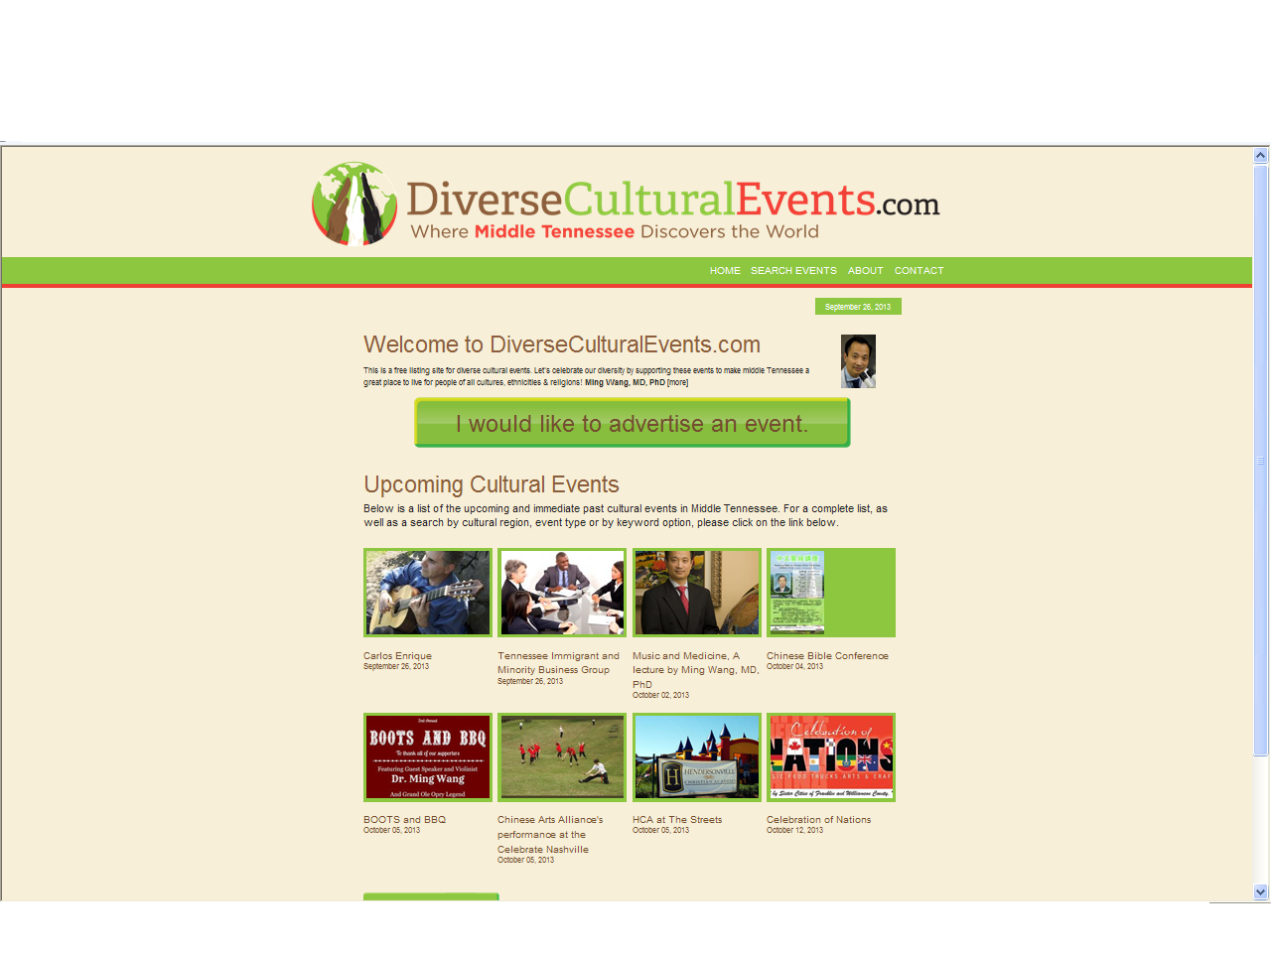

Slide 24
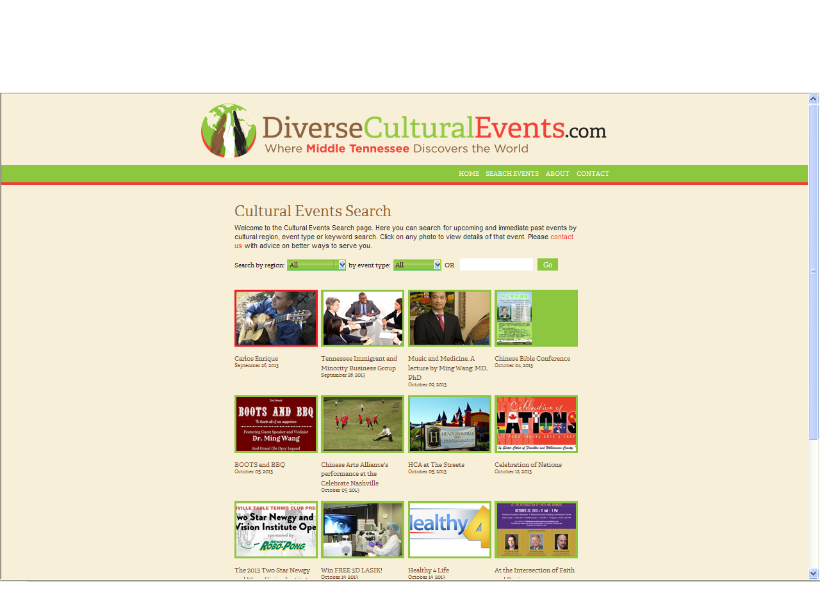

Slide 25
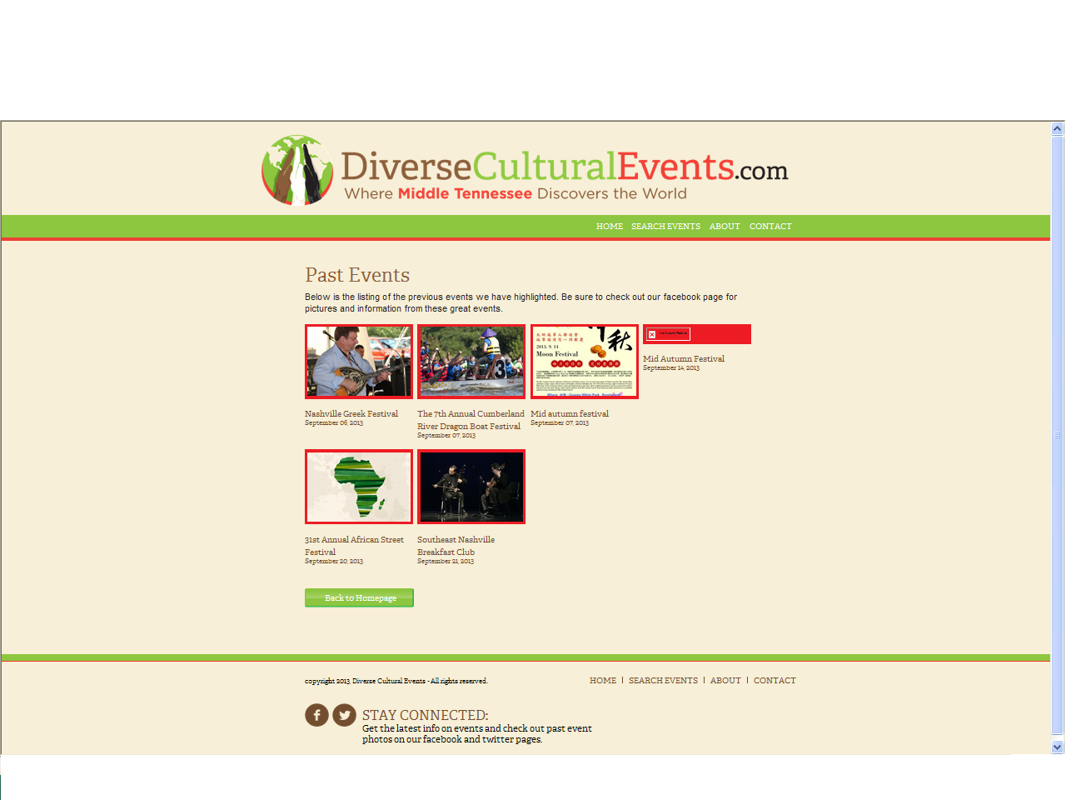

Slide 26

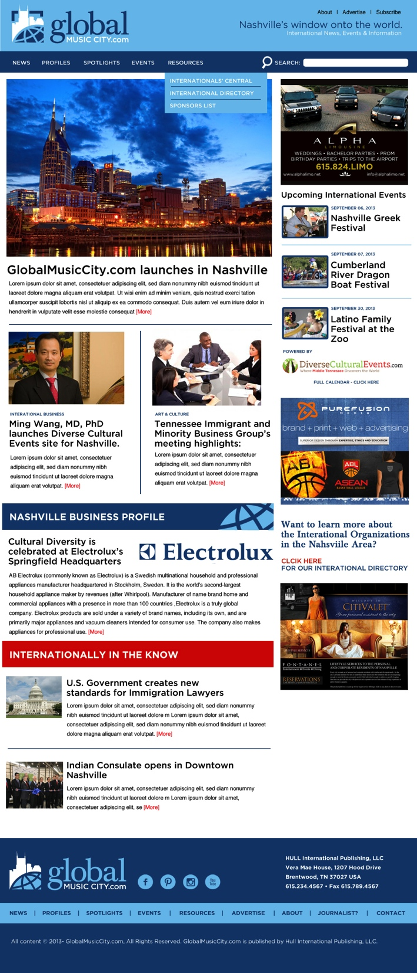
Main Homepage

Slide 27
GlobalMusicCity.com – New website going live soon
GlobalMusicCity.com has as its sole commitment the promotion of Nashville as a global business and cultural center in this age of globalization.
GlobalMusicCity.com reports on international business and cultural events from a local perspective.
GlobalMusicCity.com purports to be the only comprehensive online publication devoted to focusing on the international dimension of life in Nashville and Tennessee.
GlobalMusicCity.com tracks how local companies are engaging with the global economy and how foreign enterprises are fueling Nashville’s development as an international business hub.
GlobalMusicCity.com publishes a weekly email newsletter based on personal, in-depth reporting and published on our website.
GlobalMusicCity.com knits together Nashville's disparate international and immigrant communities, reflecting their ties with the world and helping local readers follow trends in the global economy.
GlobalMusicCity.com provides a comprehensive source for the latest academic, business and cultural events around the city and the state through its international calendar. Our readers can expect a regular selection of articles on cross-border business, education, culture and trade with a focus on "actionable" content.

Slide 28

Sponsorship Packages

